Slide 1

Chapter 4

Slide 2
OUTLINE
  Catalogue of forces.
  Newton’s laws of motion.
  Problems.

Slide 3
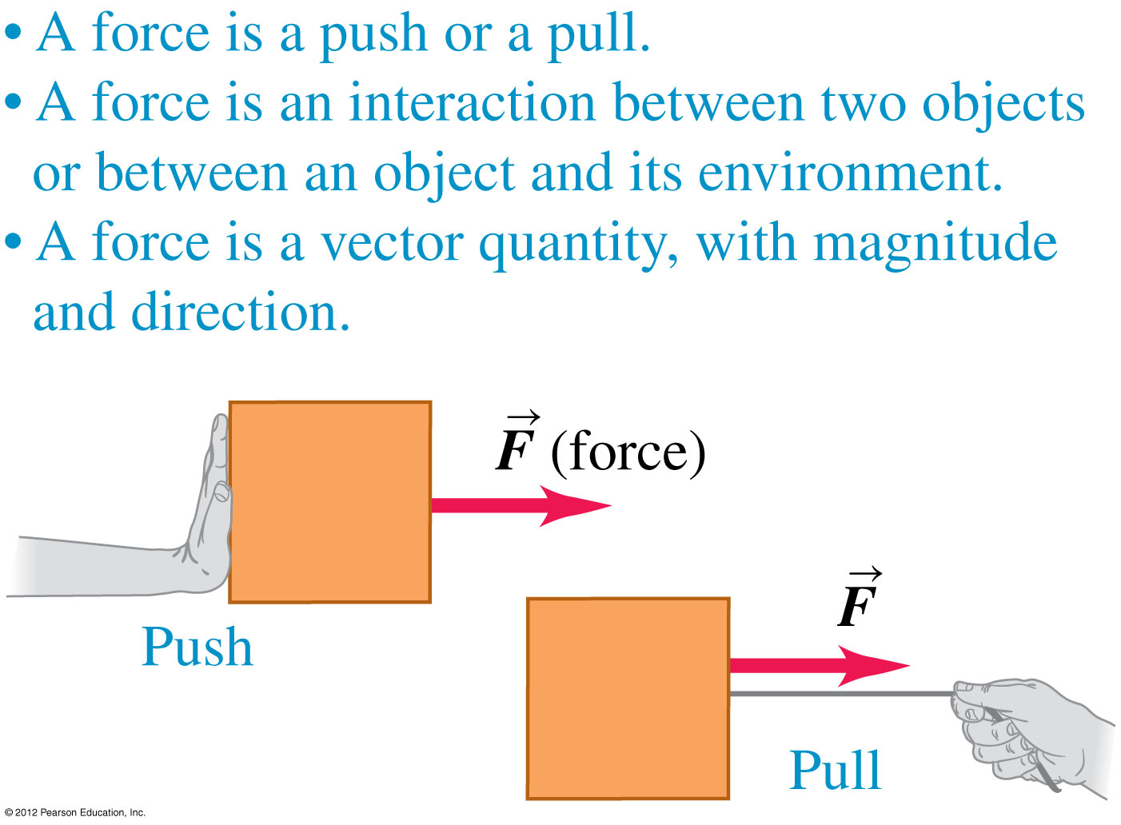
Catalogue of forces

Slide 4
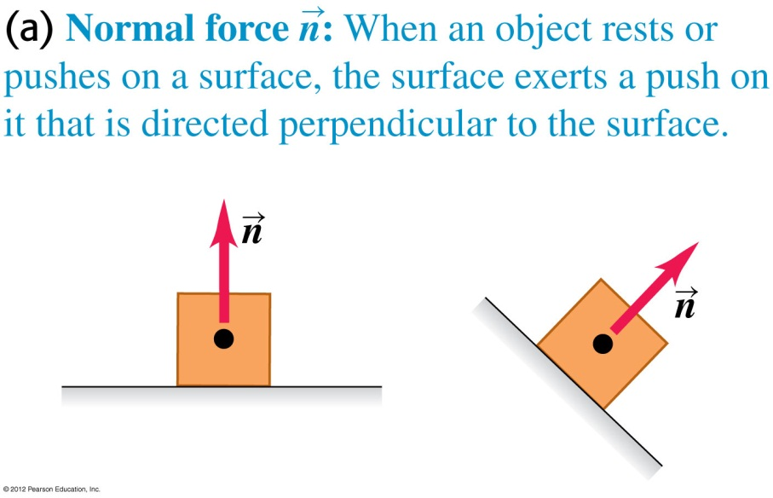
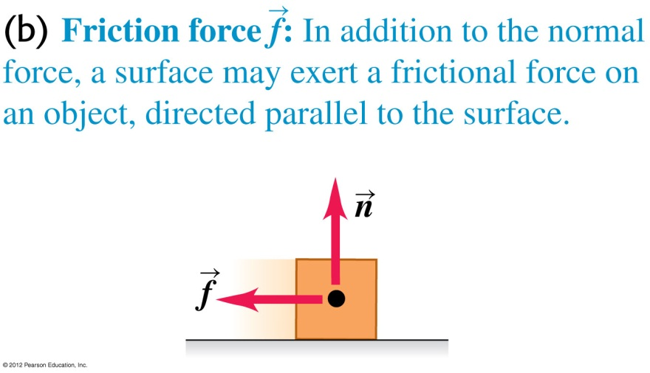
Catalogue of forces
  The normal force: When an object pushes on a surface, the surface pushes back on the object perpendicular to the surface. This is a contact force.
  Friction force: This force occurs when a surface resists sliding of an object and is parallel to the surface. Friction is a contact force.

Slide 5
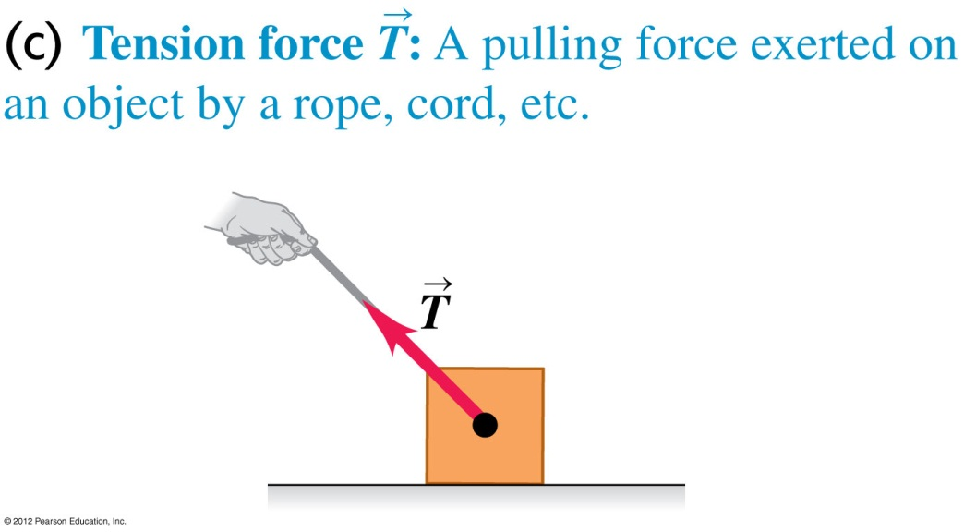
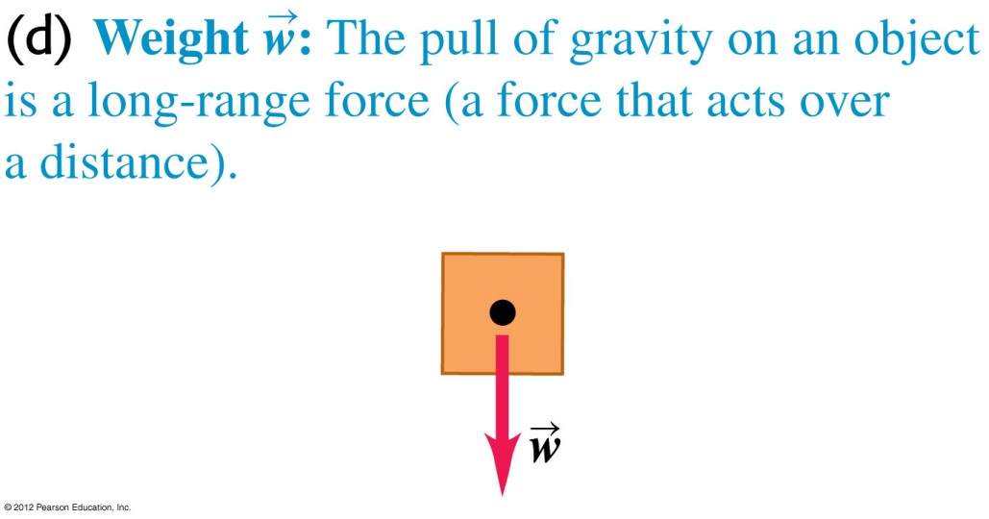
Catalogue of forces
  Tension force: A pulling force exerted on an object by a rope or cord. This is a contact force.
  Weight: The pull of gravity on an object. This is a long-range force.
  weight = (mass) x (free fall acceleration)

Slide 6
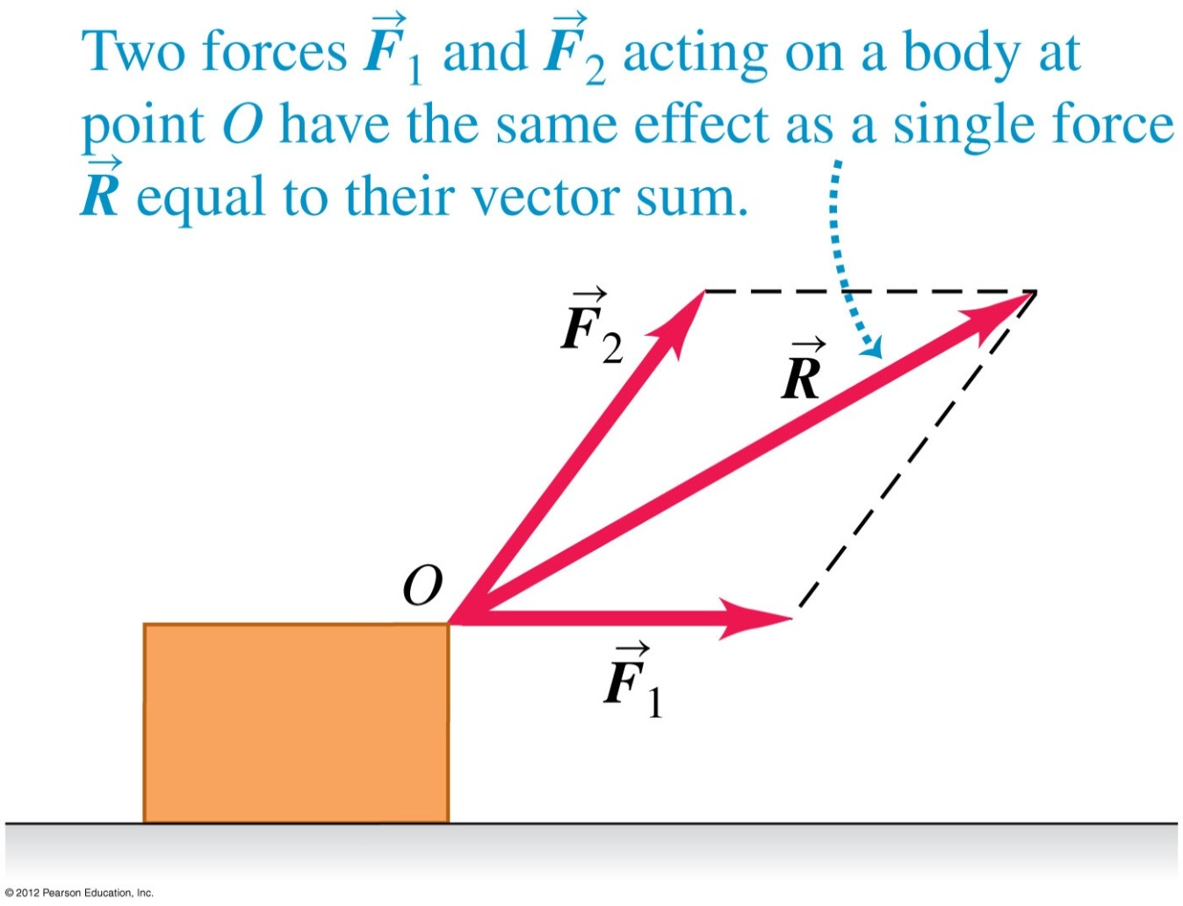
Superposition of forces
Several forces acting at a point on an object have the same effect as their vector sum acting at the same point.

Slide 7
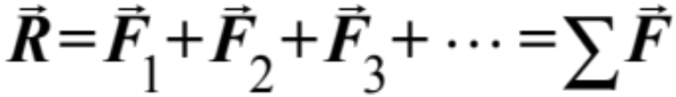
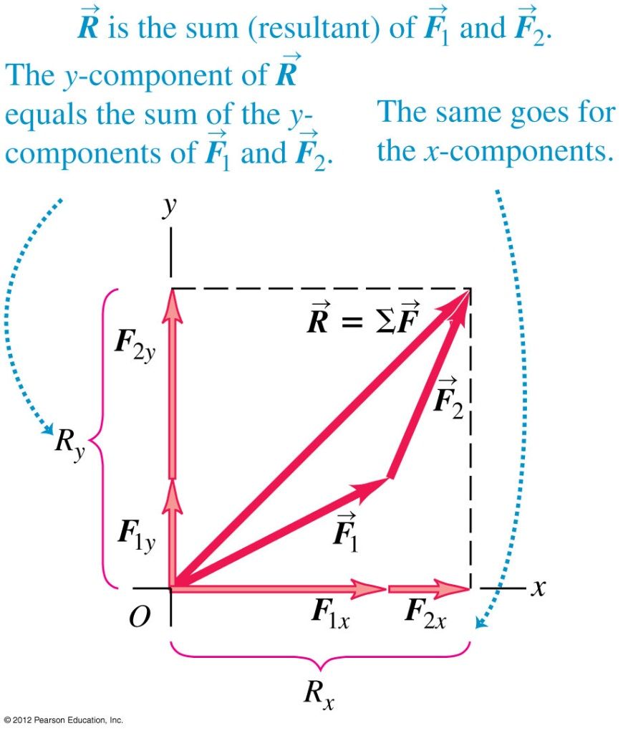
Notation for the vector sum
  The vector sum of all the forces on an object is called the resultant of the forces or the net forces.

Slide 8
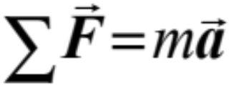
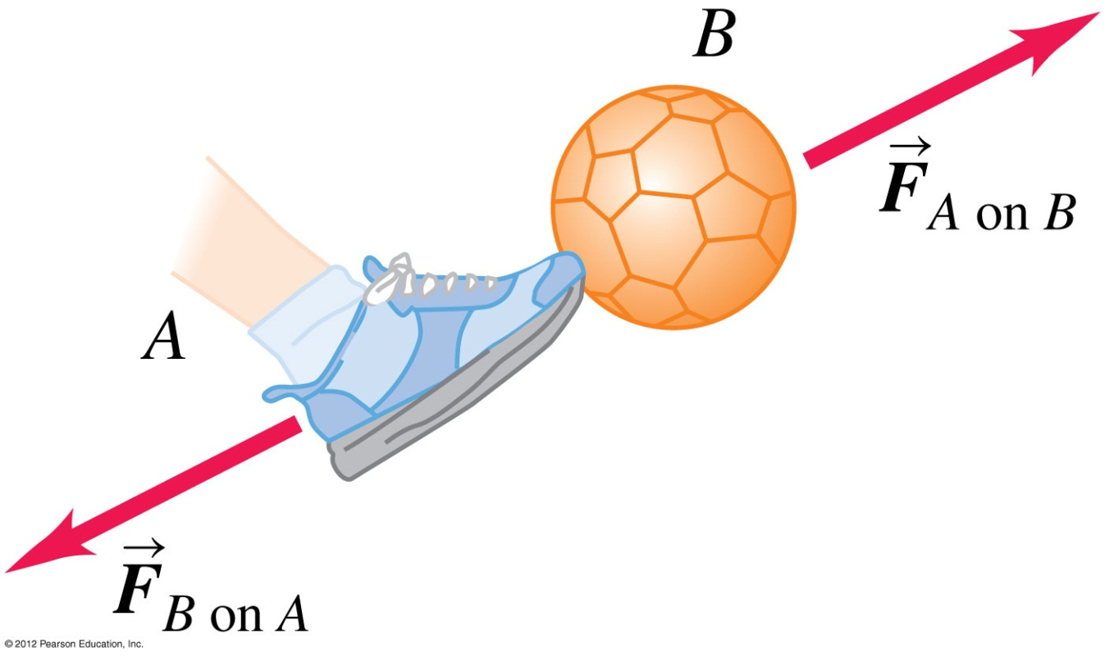
Newton’s laws of motion
First law of Newton: a body acted on by zero net force moves with constant velocity and zero acceleration.
  Second law of Newton: the acceleration of an object is directly proportional to the net force acting on it, and inversely proportional to the mass of the object.
  Third law of Newton: a force and its reaction force have the same magnitude but opposite directions (these forces act on different bodies).

Slide 9
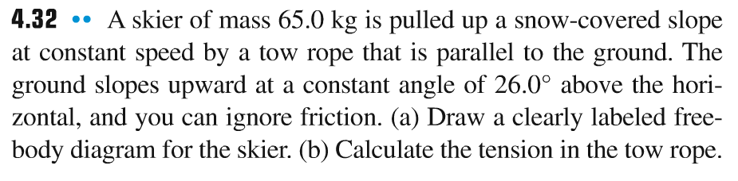
Problem #1

Slide 10
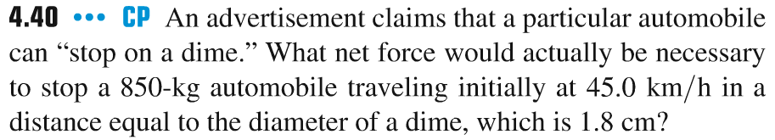
Problem #2

Slide 11
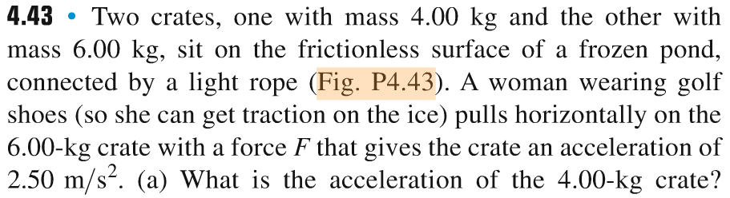
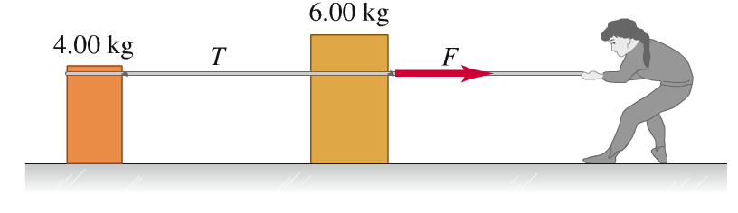
Problem #3
Find:
(a) the acceleration of the 4 kg crate;
(b) tension in the rope T;
(c) force F.

Slide 12
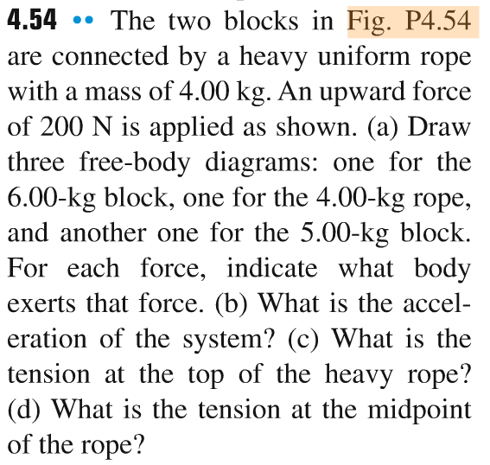
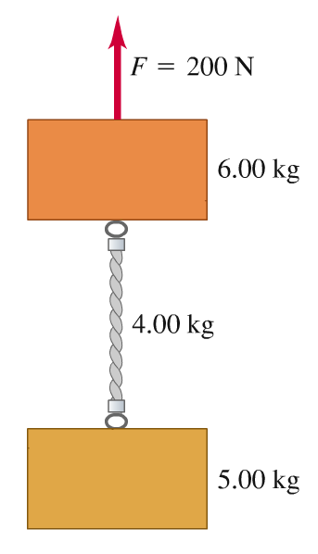
Problem #4

Slide 13
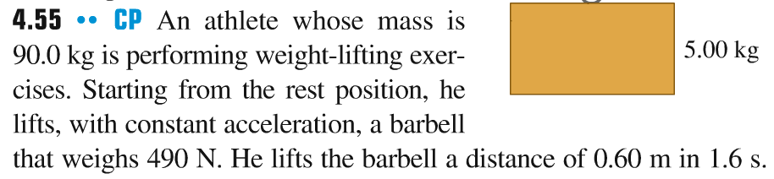
Problem #5

Slide 14
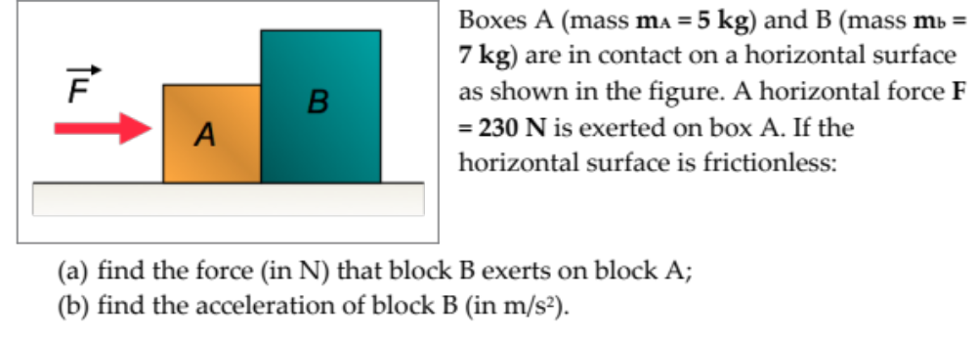
Problem #6

